Slide 2
Faculty

Slide 3
Disclosures

Slide 4
CME accreditation

Slide 5
Evaluation

Slide 6
Introduction

Slide 8
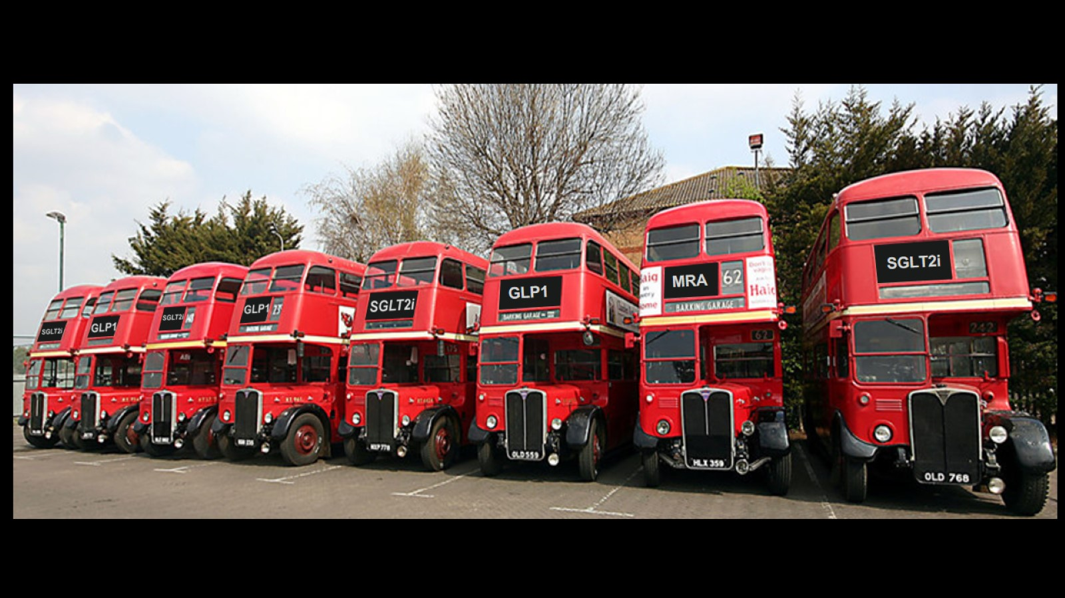

Slide 10
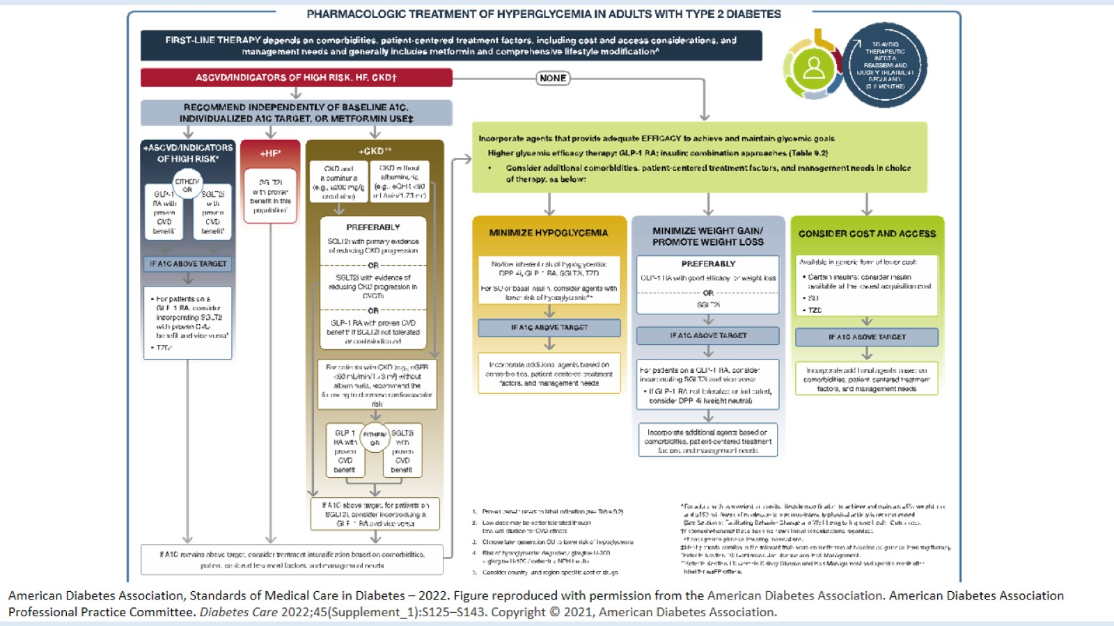

Slide 11
What are the remaining challenges?

Slide 14
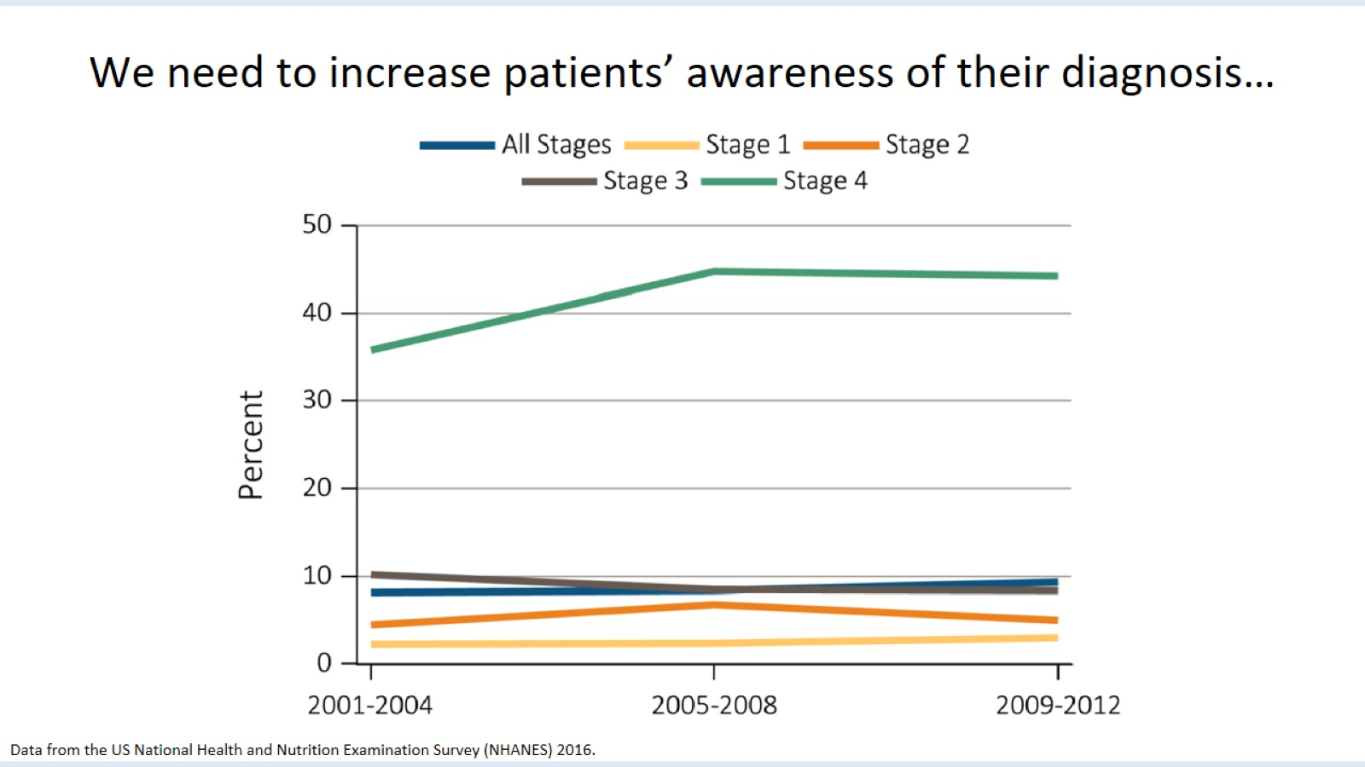

Slide 15
Why and how should we optimize care for patients with CKD?

Slide 16
Learning objectives

Slide 19
Productive Life-Years Lost Due to Premature Death or Disability in CKD

Slide 20
Low rates of CKD awareness and detection in the current era

Slide 21
Medication use in CKD stages 3–5 ND in two large US healthcare systems (N=660,000)

Slide 22
Economic impact of kidney disease

Slide 23
Costs of treatments not always highlighted to policy-makers to make decisions on investments

Slide 24
We need to act and act earlier

Slide 25
Who, when, and why to initiate appropriate therapy(/ies)

Slide 26
Understanding outcomes and treatments for different patient phenotypes

Slide 28
Screening, risk stratification, and treatment framework

Slide 29
Thesis...

Slide 30
Conceptual model of CKD

Slide 31
CKD: A case study for complex care models

Slide 32
Chronic care model: Essential components for improving outcomes

Slide 33
Best models of patient-centered, team-based care

Slide 34
Nephrologists as educators, advocators, and providers

Slide 35
Delaying progression of CKD

Slide 36
Supportive care for patients

Slide 37
The nephrology landscape is evolving: New hope

Slide 38
What does the future hold for our patients?

Slide 39
Screening, risk stratification, and treatment framework

Slide 40
Inter-related strategies to improve outcomes: Roles for nephrologists

Slide 41
Integrated clinical care: Aligned with values of best practice, best value, and best outcomes

Slide 42
Outcomes of interest: Clinical importance

Slide 43
Summary

Slide 44
In which patients should we use SGLT2 inhibitors?

Slide 48
What challenges arise in this patient?

Slide 52
Can SGLT2is improve kidney and CV outcomes in CKD?

Slide 53
DAPA-CKD: Breakdown on etiology

Slide 55
Dapagliflozin: Superior to placebo in IgAN and other glomerulonephritis

Slide 56
eGFR slowed overall in DAPA-CKD

Slide 57
SGLT2is have reduced effects on HbA1C at low eGFR

Slide 58
What challenges arise in this patient?

Slide 60
UACR decreased significantly in dapagliflozin compared with placebo

Slide 61
What challenges arise in this patient?

Slide 62
RAS and SGLT2 inhibition have combined effects on intraglomerular pressure

Slide 63
SGLT2is are mostly neutral in electrolyte balance

Slide 64
SGLT2i may complement and improve the effects of HF medications

Slide 65
What challenges arise in this patient?

Slide 66
It does not matter what your eGFR is… there is a benefit

Slide 67
Do these results apply to all non-diabetic CKD patients?

Slide 68
EMPA-KIDNEY enrols a broad CKD population

Slide 70
SGLT2is: The facts

Slide 73
Faculty Q&A

Slide 74
Summary and close

Slide 75
Evaluation

